Slide 1
self-presentation

Slide 2
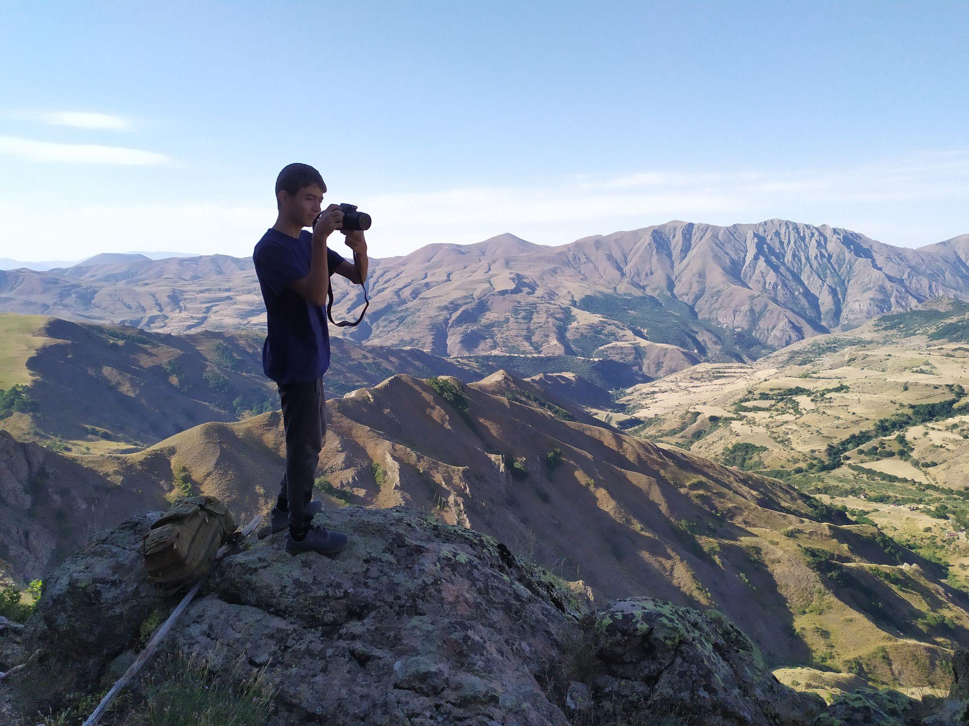
Hi
I am Andranik. I have studied at MSKH since 2019.
I’m going to tell about myself, mostly about my future profession.

Slide 3
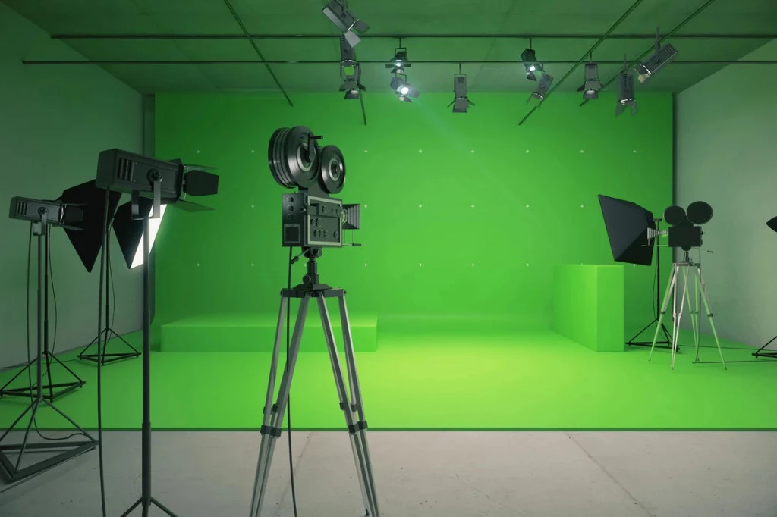
The chosen profession and its prospects
I choose the profession of director. I really like the outlook of art and the effective, beautiful method of expression in film. During the creation of the film (writing the script, storyboards, shooting and filming) it is a dynamic atmosphere.
There are good specialists in Armenia, but usually their names are unknown in our society, because they mainly work on private and foreign orders. As a result of a high-quality and responsible approach, as well as good promotion and rhetoric, excellent results can be achieved.
It is very important to be able to correctly present to all members of the film the final result of the project, as well as to ensure the promotion of the finished film.

Slide 4
What qualities are needed for this profession and do I have them, what are my limitations?
Some of the important qualities of a director are purposefulness, versatility, fantasy, the ability to compile sound and picture, and the ability to correctly express thoughts.
First of all, my main qualities are purposefulness and the ability to see the project in advance and steps in its implementation.
I try to promote all these qualities in myself and in the process of self-developing. In this process, I am limited by the lack of time and additional information, like the seminars and training sessions.

Slide 5
What skills, abilities in general do I have (personal skills)? What strengths do you see in yourself?
As I noted above, I am generally goal oriented and have been working on myself to develop my rhetoric, and have also recently started working on English as there is a huge amount of literature and video material in foreign languages. I like to experiment, I study computer technologies - contributing to the creation of films. For example, in addition to professional editing programs, I also study 3D animation programs, which are increasingly used in modern cinematography.
As a strength, I can single out the ability to imagine a particular scene in advance, as well as notice nuances while viewing existing films - each time taking into service one or another directorial skill.

Slide 6
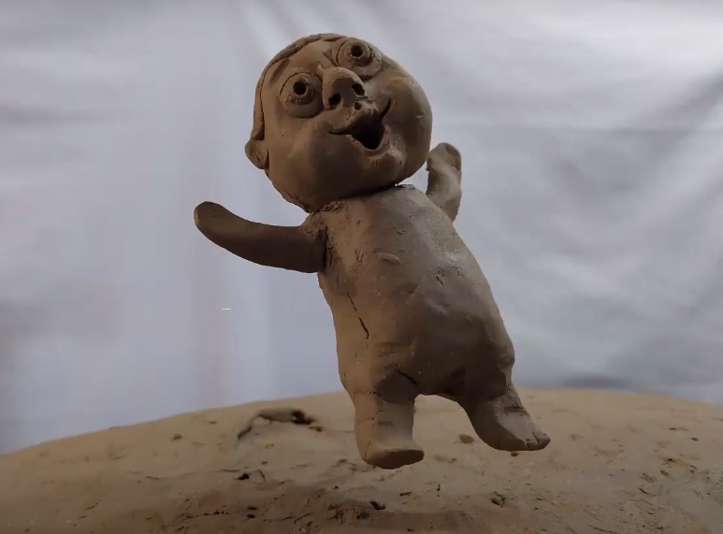
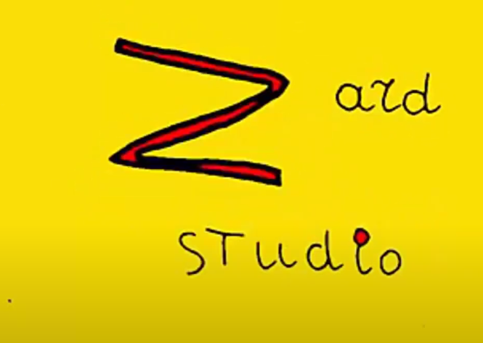
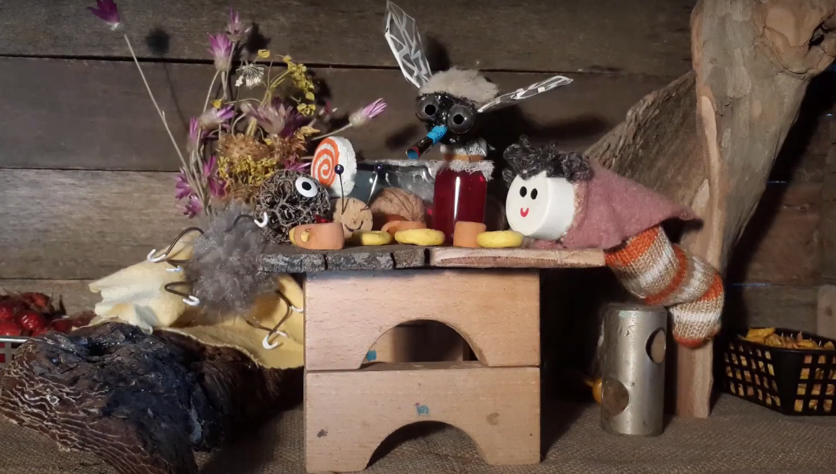
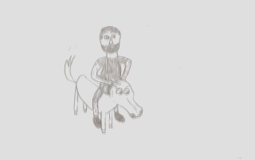
What factors influenced my choice of profession?
From primary School I knew what directing was, I started creating casts on various topics, it became a hobby, and soon I decided to create my first cartoon <<Aregak>> or <<The Sun>>. So I made several cartoons. MSKH played a big role in the development of my skills, where I got acquainted with various new technologies, especially with graphic processing in 3d / 2d animations. There I started working with “middle mskh tv” and this also influenced the development of other animation methods. And so already in the eighth grade I decided to seriously develop in the field of directing.

Slide 7
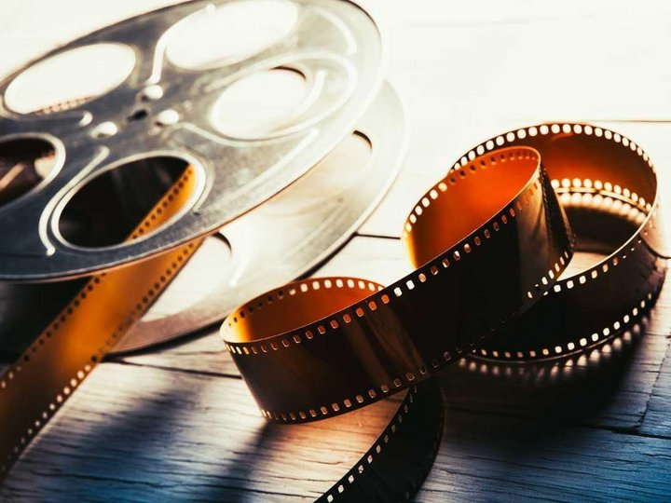
What am I doing now to get closer to my future profession?
First of all, at the moment I am working on the creation of a short film called “The Way”, studying new technologies, writing programs. I want to create a series of casts - for creating Stop motion animation, for classical animation, I am working on a program for fast filming.
I also communicate with people related to cinematography, discussing my project with them. With them, I discuss the script, storyboards, choose locations for filming and actors.

Slide 8
How do your hobbies help you in approaching your future profession?
For example, “drawing” helps in developing the appropriate skills of a storyboarder. A storyboarder is a person who, along with the director, introduces the entire film frame by frame in advance, marking the climaxes of the scenes. Either the director must have the skills of a storyboarder himself, which is preferable, or the director must be fully able to present his entire vision of the picture to his storyboarder.
Involvement in the editing process, and the ability to see the frame through the camera, is also quite useful.
It is the possession of the camera, skills in editing and drawing - hobbies that bring me closer to my future profession.

Slide 9
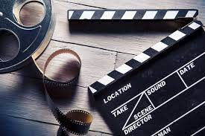
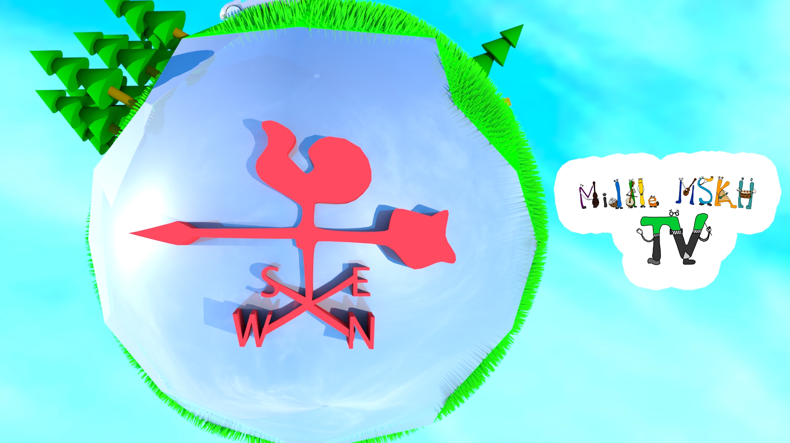
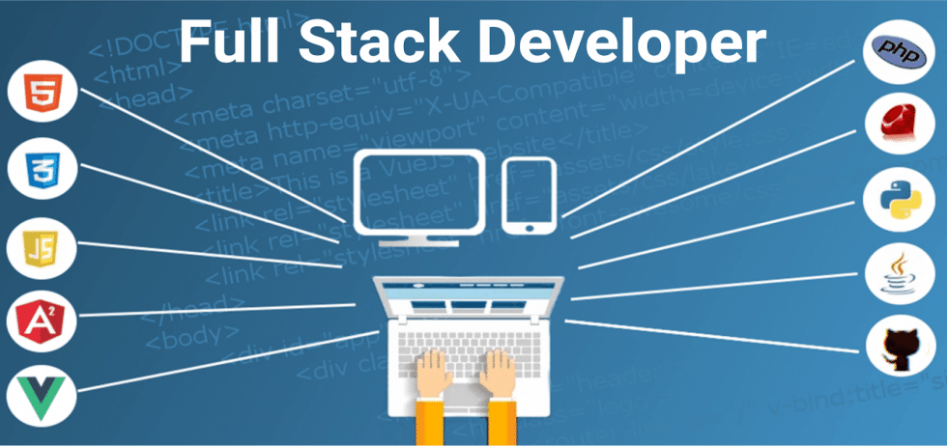
What did you achieve, what achievements did I have this year?
This year, I have decided on the choice of profession to a greater extent. My choice was marked by the beginning of work on the film.
In addition, I have achieved some positive results in working on the MiddleTV site. I learned about how the internet works in general and started working on full stack programming, as well as developing skills in other types of programming.
There are some achievements in 3D graphics, mastering new effects and technologies, studying the features of 3D texturing.

Slide 10
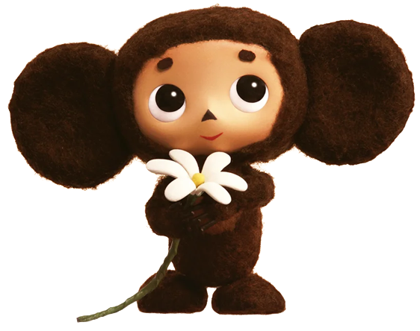
What are your goals for the near future?
In the near future I'm going to finish my projects, including the film that I'm shooting, create some programs that can help filming, develop Middle mskh tv and many more, and so on. The main thing is to know how these projects will positively influence the world, whether it is worth starting to create them. If the goal justifies the process, then work can begin.
All these projects are united by art, the creation of something new, this is what the Creator does - creating everything and everything.

